Slide 2
These slides were developed by The White Coat Investor, LLC, not a financial advisor, accountant, or attorney.
The presenter probably isn’t a financial professional either.
As such, this presentation is for your information and entertainment only and does not constitute formal, personalized financial, accounting, or legal advice.
The presenter of these slides has not been approved, certified, or trained by The White Coat Investor, LLC. In addition, the presenter may have modified the slides prior to presenting them to you. The originals can be found at www.whitecoatinvestor.com
The accuracy of any and all information in this presentation should be double-checked using a reputable source.
Notes:
Please include this slide in any presentation you give using even one of these slides to protect both you and me from liability

Slide 3
What We’ll Cover Today
Financial literacy
Student loan management for residents
Disability insurance
Term life insurance
Use of Roth retirement accounts
A written financial plan
Contract evaluation

Slide 4

Financial Literacy

Slide 5
Your Second Job
Financial Basics for Residents Financial Literacy
Med School/Residency made you a clinical expert
No business training
No personal financial or investment training
A Pension Fund Manager in a “401(k) World”
Family CFO
Not automatic

Slide 6
Your Second Job
Financial Basics for Residents Financial Literacy
You must spend time learning about finances/business
  You cannot win the game if you don’t learn the rules
  Hire professionals to teach you, not just do it for you
You must also spend the time to take care of your finances/business
  You cannot be “100% clinical” and be financially successful

Slide 7
Initial Financial Education
Financial Basics for Residents Financial Literacy
Read 4 books
  Personal Finance: Personal Finance for Dummies by Eric Tyson
  Investing: The Bogleheads Guide to Investing by Taylor Larimore et al
  Behavioral Finance: How to Think About Money by Jonathan Clements
  Physician-Specific finance: The White Coat Investor or Financial Boot Camp by Jim Dahle
The cheapest, easiest, good financial book to get through
  If You Can by William Bernstein (16-page free PDF) www.etf.com/docs/IfYouCan.pdf
Put a written financial plan in place

Slide 8
Continuing Financial Education (CFE)
Financial Basics for Residents Financial Literacy
Read one good financial book each year
Follow a good financial blog, reading 5-10 posts/month
Listen to a good financial podcast

Slide 9

Student Loan Management

Slide 10
Student Loan Burdens Worsen
Financial Basics for Residents Student Loan Management
Mean debt in 1999 ~$122K (inflation-adjusted)
Mean educational debt in 2020
  $260K for DOs
  $205K for MDs
  ½ of indebted docs have more
  $300K-$450K is becoming more common
Government won’t refinance them when rates fall
Current resident loans? 5.4%-10%

Slide 11
How Bad Can It Be?
Financial Basics for Residents Student Loan Management
Monthly payment on $400K at 7.5% = ~$4,900 per month for 10 years
If gross income = $210K and net income = $161K, $4,900 per month is 37% of net income
It’s only getting worse

Slide 12
We’re from the Government and We’re Here to Help
Financial Basics for Residents Student Loan Management
ICR
IBR
PAYE
REPAYE
PSLF
If you have federal loans, you need to become or hire an expert in these programs

Slide 13
The Income Based Repayment Programs
Financial Basics for Residents Student Loan Management
# People | Poverty Line | 150% of Poverty Line | Discretionary Income | ICR | Old IBR | New IBR/ PAYE | REPAYE
1 | $14,580 | $21,870 | $28,130 | $590 | $352 | $234 | $234
2 | $19,720 | $29,580 | $20,420 | $505 | $255 | $170 | $170
3 | $24,860 | $37,290 | $12,710 | $419 | $159 | $106 | $106
4 | $30,000 | $45,000 | $5,000 | $333 | $63 | $42 | $42
5 | $35,140 | $52,710 | – | $248 | – | – | –
6 | $40,280 | $60,420 | – | $162 | – | – | –
7 | $45,420 | $68,130 | – | $76 | – | – | –
8 | $50,560 | $75,840 | – | – | – | – | –

Slide 14
The Income Driven Repayment Programs
Financial Basics for Residents Student Loan Management
Payments have nothing to do with interest rate
Payments have almost nothing to do with debt burden
They are based solely on income and number of people in your family

Slide 15
IBR
Financial Basics for Residents Student Loan Management
Income Based Repayment
The New, Better ICR (lower payments, more hardship features)
Only income-based plan allowed if you have FFEL loans instead of Direct Loans
Payments are 15% of discretionary income (if you borrowed before 1 July 2014) or 10% (if you borrowed after)
Taxable forgiveness after 25 years of payments if you borrowed prior to
1 July 2014 or 20 years if you borrowed after
Payments count toward PSLF

Slide 16
PAYE
Financial Basics for Residents Student Loan Management
Pay As You Earn
The New, Better IBR
Not eligible if loans from pre-2007 or if no loans after 2011—must use IBR instead
Payments = 10% of Discretionary Income with a maximum of regular payment on a 10-year plan
Taxable forgiveness after 20 years of payments
Payments count toward PSLF

Slide 17
REPAYE
Financial Basics for Residents Student Loan Management
Revised Pay As You Earn
The New, Better and Worse PAYE
Payments = 10% of Discretionary Income WITHOUT a maximum
Taxable forgiveness after 25 years of payments (20 for undergrad loans)
Payments count toward PSLF
Subsidized interest during residency
Higher Payments AFTER residency

Slide 18
PSLF
Financial Basics for Residents Student Loan Management
Public Service Loan Forgiveness
ICR, IBR, PAYE, and REPAYE payments count
120 on-time payments while working full-time for a 501(c)(3)
Tax-free forgiveness
Most residencies and fellowships are 501(c)(3)s
Most academic positions are 501(c)(3)s
Many doctors working at non-profit hospitals are not employees of 501(c)(3)s
VA, military, CHCs, public health, etc.

Slide 19
PSLF
Financial Basics for Residents Student Loan Management
Why PSLF Works
  Lower payments during training
  Amount forgiven = difference between residency payments and regular payments
  Amount forgiven equals about what you owed at med school graduation
PSLF usually best option if you qualify
PSLF Side Fund (to hedge against legislative and career risk)

Slide 20
The Other Option
Financial Basics for Residents Student Loan Management
Student Loan Refinancing
Impossible after 2008 Global Financial Crisis
Possible again starting in 2013
Typical rates for an attending with good financials
  Variable 5 year of 2%-4%
  Fixed 5 year of 3.5%-5%
  Variable 10 year of 3%-4.5%
  Fixed 10 year of 4.5%-6%
You can typically get these once you have an attending contract in hand

Slide 21
Student Loan Refinancing
Financial Basics for Residents Student Loan Management
You must qualify
All docs not offered the same rates
You may not be offered the same terms
Highly dependent on debt levels, income levels, and credit
Now possible to refinance during fellowship

Slide 22
Student Loan Refinancing Companies
Financial Basics for Residents Student Loan Management
Splash
Earnest
ELFI
Credible
Laurel Road
SoFi
10+ more
WCI has negotiated lower rates and cashback with some refinancing lenders.
Discover your options at www.whitecoatinvestor.com/student-loan-refinancing/

Slide 23
Refinancing in Training
Financial Basics for Residents Student Loan Management
$100 a month payments in training
Refinance private loans
REPAYE may be better for federal loans
  Compare effective interest rates
Don’t refinance until sure about PSLF

Slide 24

Disability
Insurance

Slide 25
Your Greatest Asset
Financial Basics for Residents Disability Insurance
Protect your greatest asset
  2019 Average physician income: $313,000
  Typical career: 30 years
  $313,000 X 30 = $9.39 Million
Physicians really do become disabled
  12%-18% of Americans currently disabled
  Up to 1/3 will have a disability of at least 90 days
  Up to 1/8 will have a disability of at least 5 years
  90% caused by illness
  Docs have higher rates of musculoskeletal and mental disabilities

Slide 26
Long-Term Disability Insurance
Financial Basics for Residents Disability Insurance
Pays a monthly benefit If you become disabled for > 90 days
Benefit generally tax-free unless premium paid by employer with pre-tax dollars
You can generally insure up to 60%-70% of your income

Slide 27
Long-Term Disability Insurance
Financial Basics for Residents Disability Insurance
Buy it now
How much?
  Current spending plus
  Retirement Savings (Most policies only pay to ages 65-67)

Slide 28
Individual vs Group
Financial Basics for Residents Disability Insurance
Individual policies
  Stronger definition of disability
  Portable
  More options
  More expensive
  More difficult underwriting
Group policies (employer provided)
  Weaker definition
  Often non-portable
  Must take what is offered
  Cheaper
  Fewer pesky questions and possibly no exam at all

Slide 29
Riders
Financial Basics for Residents Disability Insurance
Residual/Partial disability
  A must have
COLA
  A must have in first half of career
Future Purchase Option
  Most residents should buy
Catastrophic Disability
  Consider just buying larger policy
Retirement Rider
  Only worth it if you cannot buy as large of a policy as you like

Slide 30
Saving Money
Financial Basics for Residents Disability Insurance
Long-term disability insurance is expensive
  2%-6% of monthly benefit
  $200-$600 per month for a $10,000 benefit
Consider individual + group policy
Buy from an independent agent
Ask for discounts
Women–Look for Unisex policies
Cancel unneeded riders
Consider graded premiums
Cancel policy when you become financially independent

Slide 31

Term Life
Insurance

Slide 32
More Income Insurance
Financial Basics for Residents Term Life Insurance
Must buy if anyone else depends on your income
Also consider covering a stay-at-home parent
Pays a tax-free cash benefit upon your death
Term is “pure” life insurance
  You die during the term, it pays

Slide 33
Term vs Whole Life Insurance
Financial Basics for Residents Term Life Insurance
Inexpensive
  10-year policy = $17/month for a $1M benefit (healthy woman)
  20-year policy = $27/month for a $1M benefit (healthy woman)
  30-year policy = $45/month for a $1M benefit (healthy woman)
  Unlike disability, women cheaper than men
Useful for income protection during your career
Whole life = life-long death benefit plus low return investment
  Costs 8X-20X as much for same benefit
  A product designed to be sold, not bought
  75% of physician purchasers regret their decision

Slide 34
How Much to Buy
Financial Basics for Residents Term Life Insurance
Decide what you want the money to do
  Allow spouse to never work?
    25X annual expenses
  Pay off house?
  Pay for college?
  Remember federal and most private student loans are forgiven at death
Add it all up and round up to nearest million
Typically $2M-$5M for most docs

Slide 35

Use Roth
Retirement Accounts

Slide 36
Retirement Accounts Rule!
Financial Basics for Residents Use Roth Retirement Accounts
Asset protection
  Most states protect 401(k)s and IRAs from your creditors
Estate planning
  Easy to designate beneficiaries, plus stretch IRAs
Cheaper rebalancing
  No taxes due upon selling an asset
Better behavior
  Penalties make it less likely you’ll raid the account inappropriately
  But there are still plenty of ways around Age 59 ½ rule

Slide 37
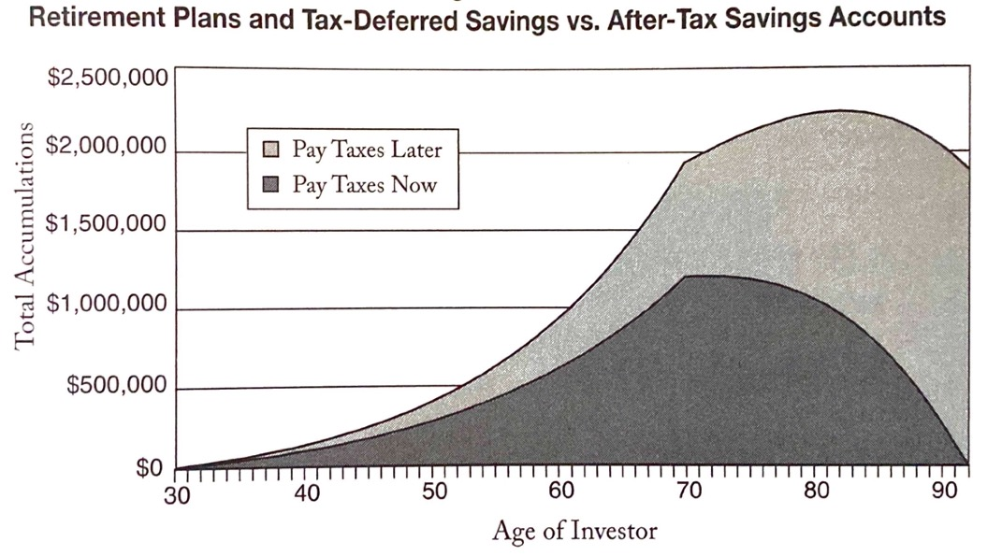
Retirement Accounts Rule!
Financial Basics for Residents Use Roth Retirement Accounts
Lower taxes = Higher returns
Source: Retire Secure by James Lange

Slide 38
Roth vs Traditional in Residency
Financial Basics for Residents Use Roth Retirement Accounts
Tax-deferred = up-front tax break
Tax-free (Roth) = tax-free at withdrawal
  You will probably be in a higher bracket in retirement than in residency
  Use if no fed student loans or no REPAYE subsidy
Tax-deferred (traditional) contributions can reduce IDR payments, increasing REPAYE subsidy and PSLF
  Use if getting a REPAYE subsidy or going for PSLF
Be sure to get any employer match
  Ask HR for plan document and read it

Slide 39
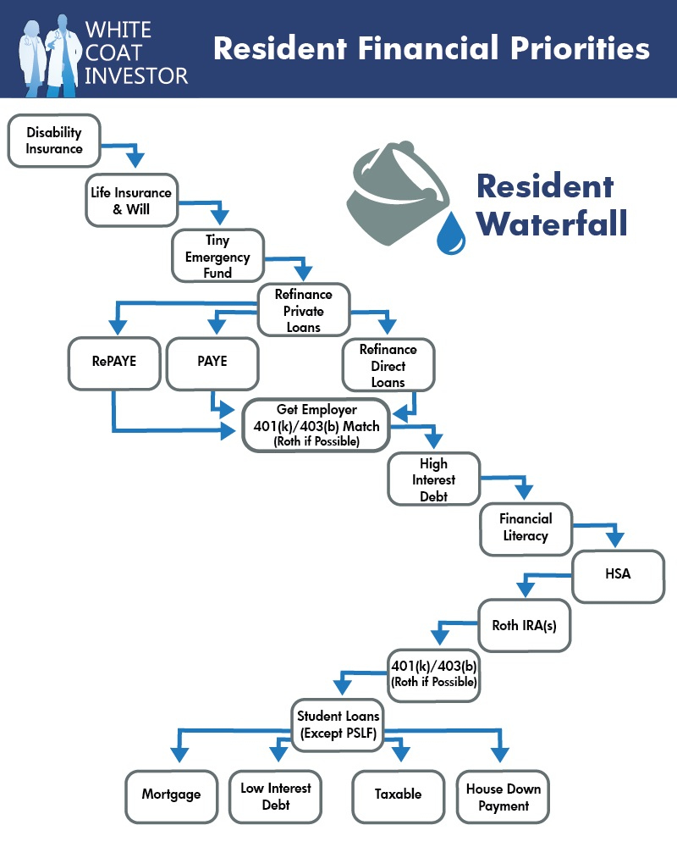
A Written
Financial Plan

Slide 40
The Secret to Physician Wealth
Financial Basics for Residents A Written Financial Plan
Make a lot of money
Don’t spend a lot of money
Make your money work as hard as you do
Don’t lose your money
  Creditors, Taxes, Death, Disability, Speculation
You’ve already won the game (the rest is easy)
Convert your high income into a high net worth

Slide 41
The Secret to Physician Wealth
Financial Basics for Residents A Written Financial Plan
LIVE LIKE A RESIDENT!

Slide 42
The Secret to Physician Wealth
Financial Basics for Residents A Written Financial Plan
Live like a resident while in training
Continue to live like a resident for a few more years
Carve out a massive chunk of your income with which to build wealth
  Pay off loans
  Save up down payment
  Max out retirement accounts
Then enjoy the good life after 2-5 years

Slide 43
Look at the Numbers
Financial Basics for Residents A Written Financial Plan
Average Resident Salary: $60K
Average Attending Salary: $320K
  Taxes $88K
  Living expenses $60K
  $172K to build wealth
    Pay off loans
    Save up down payment
    Max out retirement accounts

Slide 44
Look at the Numbers
Financial Basics for Residents A Written Financial Plan
How long will your loans survive against a $172K/year onslaught?
$100K = < 1 year
$200K = 14 months
$300K = < 2 years
$400K = < 3 years

Slide 45
Have a Written Plan
Financial Basics for Residents A Written Financial Plan
First attending year is the most important year of your financial life
Much easier to grow slowly into your attending income than cut back later
  Don’t blow your best chance to achieve financial freedom
Plan out what you will do with your first 12 paychecks BEFORE you ever
get them
Hit the ground running with a written plan

Slide 46

Contract
Evaluation

Slide 47
Be Careful Moving into the Real World
Financial Basics for Residents Contract Evaluation
50% of doctors change jobs in their first 2-3 years after residency
  Toxic jobs
  Bad partners
  Your career goals change
Do not buy a house until you are in a stable personal and professional situation
  Golden handcuffs
  Rent for 6-12 months until you know you like the job and the job likes you

Slide 48
Know What Your Contract Says
Financial Basics for Residents Contract Evaluation
Know your value
  MGMA Data
  Ask residents ahead of you for details
  Consult salary surveys
Best negotiating position is another job acceptable to you
Have contract evaluated by health care attorney in the same state as job or a national contract evaluation service
Money is fungible to most employers
  Trade benefits you don’t care about for benefits you do or for more salary, leave, etc.

Slide 49
Know What Your Contract Says
Financial Basics for Residents Contract Evaluation
How is your paycheck is determined
What happens if you leave
  How much notice
  Non-competes
What happens if you are fired
  How much notice
  Non-competes
Partnership details

Slide 50
What We Learned
You have a second job
Know your government loan programs and refinance when appropriate
Buy disability insurance
If you need insurance, buy term not whole life
Get in the habit of saving, use Roth for residents
Live like a resident and hit the ground running
Go into your job with your eyes wide open

Slide 51



For free unbiased financial tools and resources, go to
whitecoatinvestor.com
Listen to the
White Coat
Investor Podcast
Have Money Questions?
  reddit.com/r/whitecoatinvestor/
  facebook.com/groups/whitecoatinvestors

