Slide 1
Notes:
While most of the material in this presentation is timeless, some of it will eventually be out of date. Be sure to check for updated material at The White Coat Investor, especially if you are presenting these slides after 2019.

Slide 2
These slides were developed by The White Coat Investor, LLC, not a financial advisor, accountant, or attorney.
The presenter probably isn’t a financial professional either.
As such, this presentation is for your information and entertainment only and does not constitute formal, personalized financial, accounting, or legal advice.
The presenter of these slides has not been approved, certified, or trained by The White Coat Investor, LLC. In addition, the presenter may have modified the slides prior to presenting them to you. The originals can be found at www.whitecoatinvestor.com
The accuracy of any and all information in this presentation should be double-checked using a reputable source.
Notes:
Please include this slide in any presentation you give using even one of these slides to protect both you and me from liability

Slide 3
What We’ll Cover Today
Financial literacy
Living frugally
School/residency choice
Specialty choice
Student loan management
Owning vs renting during residency
Financial steps as you leave medical school

Slide 4


Financial Literacy

Slide 5
Financial Literacy
Financial Basics for Medical Students Financial Literacy
Medical school teaches you the language of medicine
Residency teaches you how to practice medicine
Neither teaches you anything about business, personal finance, or investing
Personal finance and investing has a language, just like medicine
It can be learned
  Hiring a financial advisor to teach you costs thousands of dollars but little effort
  Take the WCI Online Course (Fire Your Financial Advisor) – Cheaper but more effort
  Books are very inexpensive but require even more effort
  Blogs and internet forums are free but require a lot of effort

Slide 6
Initial Financial Education
Financial Basics for Medical Students Financial Literacy
Read 4 books
  Personal Finance: Personal Finance for Dummies by Eric Tyson
  Investing: The Bogleheads Guide to Investing by Taylor Larimore et al
  Behavioral Finance: How to Think About Money by Jonathan Clements
  Physician-Specific Finance: The White Coat Investor or Financial Boot Camp by Jim Dahle
The cheapest, easiest, good financial book to get through
  If You Can by William Bernstein (16-page free PDF) www.etf.com/docs/IfYouCan.pdf
Put a written financial plan in place

Slide 7
Continuing Financial Education (CFE)
Financial Basics for Medical Students Financial Literacy
Read one good financial book each year
Follow a good financial blog, reading 5-10 posts/month
Listen to a good financial podcast

Slide 8

Frugal
Living

Slide 9
The Real Cost of Your Purchases
Financial Basics for Medical Students Frugal Living
Every dollar you spend is really 2-3 dollars once you pay it back
  Spend carefully
How is that possible?
  The time value of money
  The effect of higher tax rates as an attending

Slide 10
The Real Cost of Your Purchases
Financial Basics for Medical Students Frugal Living
The time value of money
  Borrow $1,000 at 7% to pay rent as an MS1
  Let the interest accrue for 4 years of school, 3 of residency, 3 of fellowship
  Then pay it back over 20 years
  By the time 30 years have passed, $1,000 = $7,612
  Even if you pay it off within 5 years of fellowship graduation = $2,759

Slide 11
The Real Cost of Your Purchases
Financial Basics for Medical Students Frugal Living
The effect of higher tax rates
  Borrowed money is always after-tax
  You spend after-tax money and you pay it back with after-tax money
  Low tax bracket now vs higher bracket later
    At 45% marginal tax rate, you would have to earn $13,840 to pay off $7,612

Slide 12
Frugal Down
Financial Basics for Medical Students Frugal Living
Be a poor medical student
  Easiest time to be poor in your life – everyone around you is poor too
Limit how much you eat out
  Free food at the hospital!
You aren’t what you drive
  Reliable transportation costs $5,000
Get roommates if single
Send partner to work if not single

Slide 13
Minimize Debt
Financial Basics for Medical Students Frugal Living
Spend less
Use savings and family help first
Don’t take out debt until you must
  Med school loans aren’t subsidized
  Don’t borrow a year’s worth of money in August
Consider working – summer before MS2, during MS4 year
If you must borrow, get the best terms
  Max out federal loans before private
  Consider home equity, family loans, 0% credit cards

Slide 14

School & Residency Choice

Slide 15
Consider School/Residency Cost
Financial Basics for Medical Students School & Residency Choice
Cost of attendance of medical school is highly variable
U of Texas 2021-2022
  Tuition: $22,651 (in-state)
  COA: $53,529
USC 2020-2021
  Tuition: $66,150
  COA: $100,261
Consider attending the cheapest school you can get into
Don’t forget the cost of living too

Slide 16
Consider School/Residency Cost
Financial Basics for Medical Students School & Residency Choice
Location is primary financial factor for residency
Rent can vary by > 4X between the Midwest/South and New York/California/DC
  A married resident with several kids and a stay-at-home spouse will feel very poor in many locations
Residency salaries vary, but not by a lot
Consider moonlighting opportunities
Fit and quality of education matter more than location, but it’s a close third

Slide 17
Consider School/Residency Cost
Financial Basics for Medical Students School & Residency Choice
When you find yourself in a hole, stop digging
  Don’t borrow more money in residency
    Not for living expenses
    Not for cars
    Probably not even for a home
  Debt limits your options
    Overcome the debt anesthesia you picked up in med school

Slide 18
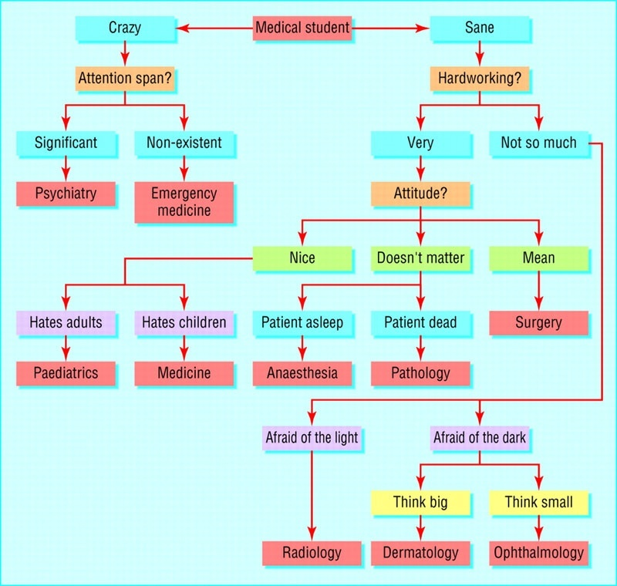
Specialty
Choice

Slide 19
The Truth About Medicine and Money
Financial Basics for Medical Students Specialty Choice
How much you get paid does not depend on:
  How much you know
  How long you trained
  How unpleasant your work is
Market forces do not work well in medicine
Procedures pay better than thinking

Slide 20
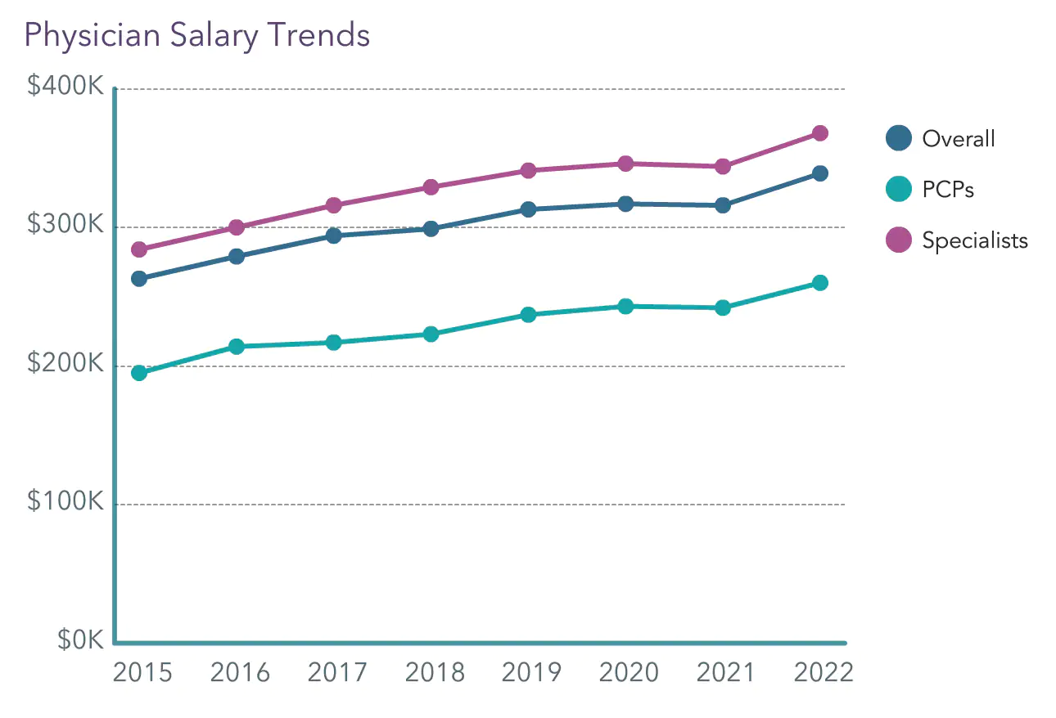
The Truth About Medicine and Money
Financial Basics for Medical Students Specialty Choice
Doctor salaries are rising
($339K in 2022)
2022 Medscape Physician Compensation Survey

Slide 21
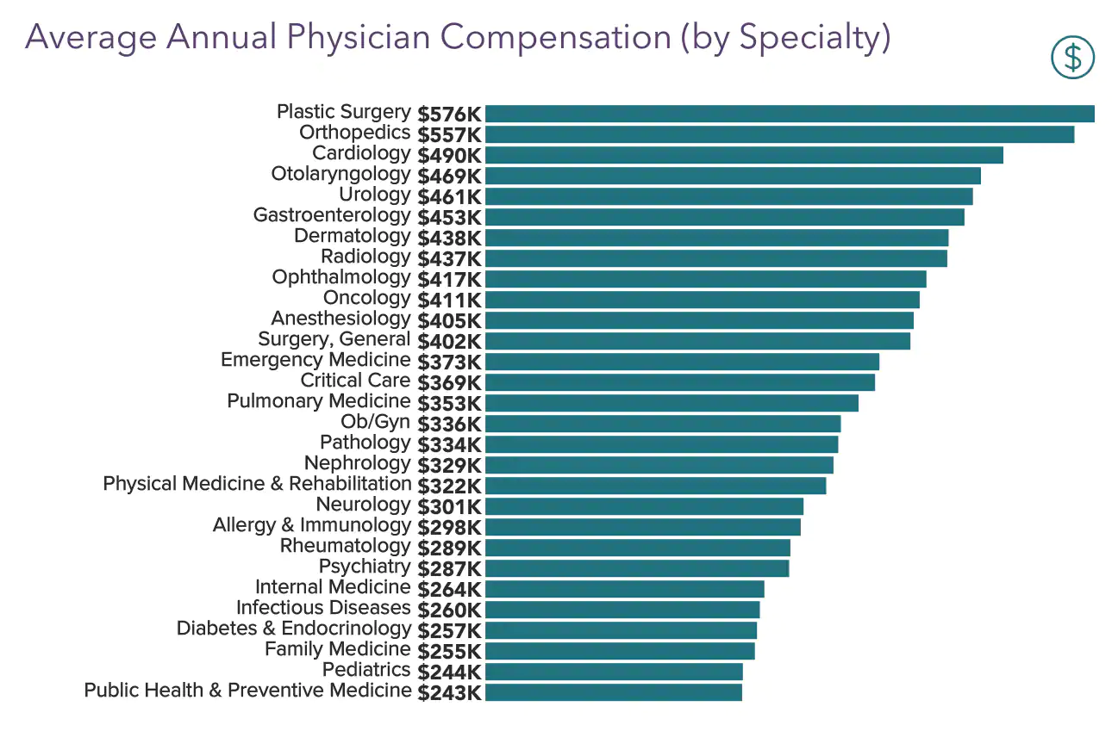
Financial Basics for Medical Students Specialty Choice
The Truth About Medicine and Money
Some specialties pay better than others (2022 survey)

Slide 22
The Truth About Medicine and Money
Financial Basics for Medical Students Specialty Choice
Despite the averages, intraspecialty pay varies by more than interspecialty pay
There are psychiatrists and family practitioners making seven figure incomes

Slide 23
The Truth About Medicine and Money
Financial Basics for Medical Students Specialty Choice
If you cannot live on $200,000, you have a spending problem, not an earning problem
That said, it is still easier to pay off debt, build wealth, give to charity, and buy expensive stuff if your income is higher
You will care about your income and lifestyle a lot more 10 years out of residency than as an MS3 choosing a specialty

Slide 24
The Truth About Medicine and Money
Financial Basics for Medical Students Specialty Choice
The most important factor is choosing something you will love doing for a
long time
  You will be better off as a pediatrician for 30 years than spending an extra 3 years training to do critical care and then burning out in 10
But . . . if you love two specialties equally, choose the one that pays more and/or has a better lifestyle

Slide 25

Student Loan Management

Slide 26
The Federal Programs
Financial Basics for Medical Students Student Loan Management
ICR
IBR
PAYE
REPAYE
PSLF
If you have federal loans, you need to become or hire an expert in these programs

Slide 27
The Income Based Repayment Programs
Financial Basics for Medical Students Student Loan Management
# People | Poverty Line | 150% of Poverty Line | Discretionary Income | ICR | Old IBR | New IBR/ PAYE | REPAYE
1 | $14,580 | $21,870 | $28,130 | $590 | $352 | $234 | $234
2 | $19,720 | $29,580 | $20,420 | $505 | $255 | $170 | $170
3 | $24,860 | $37,290 | $12,710 | $419 | $159 | $106 | $106
4 | $30,000 | $45,000 | $5,000 | $333 | $63 | $42 | $42
5 | $35,140 | $52,710 | – | $248 | – | – | –
6 | $40,280 | $60,420 | – | $162 | – | – | –
7 | $45,420 | $68,130 | – | $76 | – | – | –
8 | $50,560 | $75,840 | – | – | – | – | –

Slide 28
The Income Driven Repayment Programs
Financial Basics for Medical Students Student Loan Management
Payments have nothing to do with interest rate
Payments have almost nothing to do with debt burden
They are based solely on income and number of people in your family

Slide 29
ICR
Financial Basics for Medical Students Student Loan Management
Income Contingent Repayment
Started in 1994
Payments = The lesser of 20% of discretionary income or a fixed 12-Year payment
Taxable forgiveness after 25 years of payments
Payments count towards PSLF
Very few still in this program because IBR is almost always better
Covers direct Parent PLUS loans once consolidated

Slide 30
IBR
Financial Basics for Medical Students Student Loan Management
Income Based Repayment
The New, Better ICR (lower payments, more hardship features)
Only income-based plan allowed if you have FFEL loans instead of Direct Loans
Payments are 15% of discretionary income (if you borrowed before 1 July 2014) or 10% (if you borrowed after)
Taxable forgiveness after 25 years of payments if you borrowed prior to
1 July 2014 or 20 years if you borrowed after
Payments count toward PSLF

Slide 31
PAYE
Financial Basics for Medical Students Student Loan Management
Pay As You Earn
The New, Better IBR
Not eligible if loans from pre-2007 or if no loans after 2011 – must use IBR instead
Payments = 10% of discretionary income with a maximum of regular payment on a 10-year plan
Taxable forgiveness after 20 years of payments
Payments count toward PSLF

Slide 32
REPAYE
Financial Basics for Medical Students Student Loan Management
Revised Pay As You Earn
The New, Better, and Worse PAYE
Payments = 10% of discretionary income WITHOUT a maximum
Taxable forgiveness after 25 years of payments (20 for undergrad loans)
Payments count toward PSLF
Subsidized interest during residency
Higher payments AFTER residency

Slide 33
REPAYE
Financial Basics for Medical Students Student Loan Management
Imagine $200K in debt at 6% interest
$1000 interest per month
If required payment is $200
  $400 of interest added to loan
  $400 is waived

Slide 34
PSLF
Financial Basics for Medical Students Student Loan Management
Public Service Loan Forgiveness
ICR, IBR, PAYE, and REPAYE payments count
120 on-time payments while working full-time for a 501(c)(3)
Tax-free forgiveness
Most residencies and fellowships are 501(c)(3)s
Most academic positions are 501(c)(3)s
Many doctors working at non-profit hospitals are not employees of 501(c)(3)s
VA, military, CHCs, public health, etc.

Slide 35
PSLF
Financial Basics for Medical Students Student Loan Management
Why PSLF Works
  Lower payments during training
  Amount forgiven = difference between residency payments and regular payments
  Amount forgiven equals about what you owed at med school graduation
PSLF usually best option if you qualify
PSLF Side Fund (to hedge against legislative and career risk)

Slide 36
The Other Option
Financial Basics for Medical Students Student Loan Management
Student Loan Refinancing
Typical rates for an attending with good financials
  Variable 5 year of 2%-4%
  Fixed 5 year of 3.5%-5%
  Variable 10 year of 3%-4.5%
  Fixed 10 year of 4.5%-6%
You can typically get these once you have an attending contract in hand

Slide 37
Student Loan Refinancing
Financial Basics for Medical Students Student Loan Management
You must qualify
All docs not offered the same rates
You may not be offered the same terms
Highly dependent on debt levels, income levels, and credit

Slide 38
Student Loan Refinancing Companies
Financial Basics for Medical Students Student Loan Management
Splash
Earnest
ELFI
Credible
Laurel Road
SoFi
10+ more
WCI has negotiated lower rates and cashback with some refinancing lenders
Discover your options at www.whitecoatinvestor.com/student-loan-refinancing/

Slide 39
Refinancing in Residency
Financial Basics for Medical Students Student Loan Management
Private loans can always be refinanced
Federal loans can be refinanced if
  You are sure you won’t use PSLF
  Effective rate < than REPAYE
  $100 a month payments in training
Rates higher than for attendings
You can always refinance again

Slide 40
How to Pay Off Loans in 2-5 Years
Financial Basics for Medical Students Student Loan Management
Average debt at graduation $200,000
Average physician salary $320,000
Average resident salary $60,000
Live like a resident
Attending budget
  $90K in taxes
  $60K in living expense
  $170K toward student loans
  Even if $50K toward retirement accounts, still gone in 3 years

Slide 41
Live Like a Resident!
Financial Basics for Medical Students Student Loan Management
Four most important words in this presentation
The secret to physician wealth
By living like a resident for 2-5 years you can
  Pay off your student loans
  Save up a down payment on your dream home
  Build a great starter nest egg
Then dial it back to a savings rate of 20% of gross income

Slide 42

Why Residents Should Rent

Slide 43
Fight the Burning Desire!
Financial Basics for Medical Students Why Residents Should Rent
Graduating medical students (and especially their partners) have a burning desire to buy a house
Owning a house is not the American dream
Renting is not throwing away money
  It is exchanging money for housing
  Property taxes, realtor fees, mortgage interest is all “throwing money away” too

Slide 44
Fight the Burning Desire!
Financial Basics for Medical Students Why Residents Should Rent
Rent payments are supposed to be more than mortgage payments due to other costs of homeownership
Selling a house for more than you bought it for does not mean you made money
  Transaction costs are typically 5% to buy and 10% to sell
You actually make money:
  ~ ⅓ of the time in a 3-year residency
  ~ ½ the time in a 5-year residency

Slide 45
Fight the Burning Desire!
Financial Basics for Medical Students Why Residents Should Rent
Renting allows you to focus on training
Mortgage interest isn’t deductible for most residents
  Standard deduction $12,950 ($25,900 married)
Residency graduation is a difficult time to sell a home

Slide 46

Financial Steps As You Leave Medical School

Slide 47
Student Loans
Financial Basics for Medical Students Financial Steps As You Leave Medical School
Refinance private loans STAT
Enroll in IDR program immediately by consolidating your federal student loans right after graduation and start making payments ASAP
  REPAYE for singles and single earners
  Get advice for dual earners (studentloanadvice.com)
  REPAYE MFJ vs PAYE MFS

Slide 48
Insurance
Financial Basics for Medical Students Financial Steps As You Leave Medical School
3. Buy disability insurance ASAP
  Protect your most valuable asset
  Own-occupation, specialty-specific
  Residency program may offer it
  Consider buying individual/portable policy
4. Buy term life insurance
  If anyone else depends on your income
  Avoid Whole Life Insurance
5. Umbrella (personal liability) policy
  Inexpensive

Slide 49
Learn to Live on Less Than You Make
Financial Basics for Medical Students Financial Steps As You Leave Medical School
6. Make a budget, prioritizing your values
  Live on it
  Residents make the average household salary
7. Start saving some money
  Get the match if your 401(k) or 403(b) offers it
  Preferentially use Roth (tax-free) accounts

Slide 50
What We Learned
Become financially literate, it’s your second job
Assume everything you buy costs 3X the sticker price
Consider cost of living when choosing residency
Choose a specialty carefully
Have a written plan for managing your student loans
Renting a home during residency should be the default choice
Hit the ground running with a solid financial plan as you receive your first paycheck

Slide 51



For free unbiased financial tools and resources, go to
whitecoatinvestor.com
Listen to the
White Coat
Investor Podcast
Have Money Questions?
  reddit.com/r/whitecoatinvestor/
  facebook.com/groups/whitecoatinvestors

