Slide 1
Notes:
While most of the material in this presentation is timeless, some of it will eventually be out of date. Be sure to check for updated material at The White Coat Investor, especially if you are presenting these slides after 2019.

Slide 2
These slides were developed by The White Coat Investor, LLC, not a financial advisor, accountant, or attorney.
The presenter probably isn’t a financial professional either.
As such, this presentation is for your information and entertainment only and does not constitute formal, personalized financial, accounting, or legal advice.
The presenter of these slides has not been approved, certified, or trained by The White Coat Investor, LLC. In addition, the presenter may have modified the slides prior to presenting them to you. The originals can be found at www.whitecoatinvestor.com
The accuracy of any and all information in this presentation should be double-checked using a reputable source.
Notes:
Please include this slide in any presentation you give using even one of these slides to protect both you and me from liability

Slide 3
What We’ll Cover Today
Financial literacy
Student loan management for attendings
Financial advisors
The five insurance policies you need and two you don't
Basics of retirement accounts
The benefits of index funds
Basics of estate planning
Basics of asset protection

Slide 4

Financial Literacy

Slide 5
Your Second Job
Financial Basics for Attendings Financial Literacy
Med School/Residency made you a clinical expert
No business training
No personal financial or investment training
A Pension Fund Manager in a “401(k) World”
Family CFO
Not automatic

Slide 6
Your Second Job
Financial Basics for Attendings Financial Literacy
You must spend time learning about finances/business
  You cannot win the game if you don’t learn the rules
  Hire professionals to teach you, not just do it for you
You must also spend the time to take care of your finances/business
  You cannot be “100% clinical” and be financially successful

Slide 7
Initial Financial Education
Financial Basics for Attendings Financial Literacy
Read 4 books
  Personal Finance: Personal Finance for Dummies by Eric Tyson
  Investing: The Bogleheads Guide to Investing by Taylor Larimore et al
  Behavioral Finance: How to Think About Money by Jonathan Clements
  Physician-Specific finance: The White Coat Investor or Financial Boot Camp by Jim Dahle
The cheapest, easiest, good financial book to get through
  If You Can by William Bernstein (16-page free PDF) www.etf.com/docs/IfYouCan.pdf
Put a written financial plan in place

Slide 8
Continuing Financial Education (CFE)
Financial Basics for Attendings Financial Literacy
Read one good financial book each year
Follow a good financial blog, reading 5-10 posts/month
Listen to a good financial podcast

Slide 9

Student Loan Management

Slide 10
Student Loans for Attendings
Financial Basics for Attendings Student Loan Management
Private loans
  Refinance all private loans
  Best terms are on 5-year variable loans
  Refinance again every time you get lower rates
    Rates drop
    Debt-to-income ratio improves
    Your credit score improves
WCI has negotiated lower rates and cashback with some refinancing lenders – discover your options at www.whitecoatinvestor.com/student-loan-refinancing/

Slide 11
Student Loans for Attendings
Financial Basics for Attendings Student Loan Management
Federal loans
  Are you working full-time for a 501(c)(3) or government employer?
  Did you make a lot of small IDR payments during residency/fellowship?
    If the answer to both of those is yes, then go for PSLF, but save up a PSLF side fund.
    If no...
  Do you owe more than 2.5X your gross income?
    If so, consider PAYE/REPAYE forgiveness and get some professional advice
    If not, refinance and pay them off

Slide 12
How to Pay Off Student Loans Quickly
Financial Basics for Attendings Student Loan Management
Send large checks every month to the lender
Easiest to do right out of residency before lifestyle inflation
Live like a resident!
  The secret to being a wealthy physician

Slide 13
Run the Numbers
Financial Basics for Attendings Student Loan Management
Average Resident Salary: $60K
Average Attending Salary: $320K
  Taxes $90K
  Living expenses $60K
  $170K to build wealth
    Pay off loans
    Save up down payment
    Max out retirement accounts

Slide 14
Run the Numbers
Financial Basics for Attendings Student Loan Management
How long will your loans survive against a $170K/year onslaught?
  $100K = < 1 year
  $200K = 14 months
  $300K = < 2 years
  $400K = < 3 years

Slide 15

Financial
Advisors

Slide 16
William Bernstein on Financial Advisors
"You are engaged in a life-and-death struggle with
the financial services industry. . . If you act on the assumption that every broker, insurance
salesman . . . and financial advisor you encounter is
a hardened criminal, you will do just fine.“
- William Bernstein, MD

Slide 17
Finding a Good Advisor
Financial Basics for Attendings Financial Advisors
Commitment to profession
    CFA, CFP, ChFC, CPA/PFS
More experience than you
No commissions (fee-only)
Fiduciary duty
Knowledge of investing literature
Experience with physician-specific issues
    Taxes
    Student loan issues
    Retirement account issues

Slide 18

The Cost of Financial Advice
Financial Basics for Attendings Financial Advisors
If you pay just 2% of your portfolio each year in fees, commissions, and expenses, how much less would you end up with?
  30 years, 8% pre-fee returns, saving $50K a year
  $6.1M vs $4.2M
  Is that advisor really worth nearly $2M to you?
    5+ years of your gross salary?
    $80K/year in retirement?

Slide 19
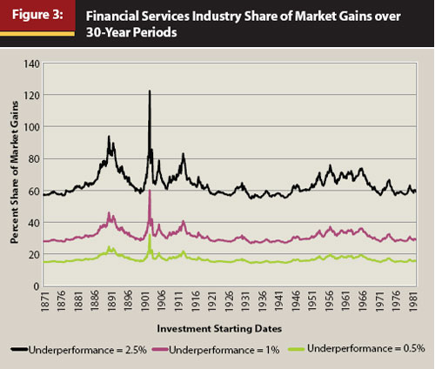
The Tyranny of Compounding Fees
Financial Basics for Attendings Financial Advisors
Source: Neufeld – Journal of Financial Planning 2014

Slide 20
Financial Advisory Models
Financial Basics for Attendings Financial Advisors
Commissions
    Loaded mutual funds
    Commissions on insurance-based investing products
    Worst products pay best commissions
Asset Under Management Fee
    (0.15%-2%) ($1,500-$20,000 on a $1M portfolio)
Annual retainer
    ($1,000-$5,000) or set fee for plan ($500-$2,000)
Hourly rate
    (typically $200-$400/hour)
** A fair price is a four-figure amount per year

Slide 21

The Right Insurance

Slide 22
Insure Against Financial Catastrophe
Financial Basics for Attendings The Right Insurance
High deductibles, low premiums
If you can self-insure, do so
Health insurance
Term Life insurance – buy $1M-$5M of 30-year level
Disability insurance
Umbrella policy – buy $1M-$5M
Malpractice
Don’t mix insurance and investing
  Doctors, especially new ones, don’t need Whole Life insurance

Slide 23
The Five Insurances You Need
Financial Basics for Attendings The Right Insurance
Health insurance
Disability insurance
Liability insurance
    Umbrella (personal liability) – $1M-$5M
    Malpractice (professional liability) – same as others of same specialty
Term Life insurance – buy $1M-$5M of 30-year level
Homeowner’s/Renter’s insurance

Slide 24
Two Insurances You Don’t Need
Financial Basics for Attendings The Right Insurance
Whole Life Insurance
  A lifelong insurance policy with a cash value you can borrow against
  8-20X the cost of term life for same death benefit
  Cash value has low returns – takes 5-15 years to break even
  High commissions – a product designed to be sold, not bought
  75% of physician buyers regret their purchase

Slide 25
Two Insurances You Don’t Need
Financial Basics for Attendings The Right Insurance
2. Long-term care insurance
  Poor and single people can spend down to Medicaid levels
  Multi-millionaires can self-insure
  Married middle class ($200K-$1.5M nest egg) should consider
  Not quite ready for prime time
    Companies go out of business
    Premiums raised and no longer affordable

Slide 26

Your Greatest
Tax Break

Slide 27
Retirement Accounts
Financial Basics for Attendings Your Greatest Tax Break
Your second job
Read your plan document
Understand all tax-advantaged accounts available to you and how they work
  Private practice
    401(k)/Profit-sharing plan
    Defined Benefit/Cash Balance Plan
  Academic
    403(b), 457(b), 401(a)

Slide 28
Retirement Accounts
Financial Basics for Attendings Your Greatest Tax Break
Understand all tax-advantaged accounts available to you and how they work
  Self-employed
    Individual 401(k)
    SEP-IRA (i401(k) better)
    Personal Defined Benefit Plan
  Everybody
    Backdoor Roth IRA (personal and spousal)
    Health Savings Account
    529s for college

Slide 29
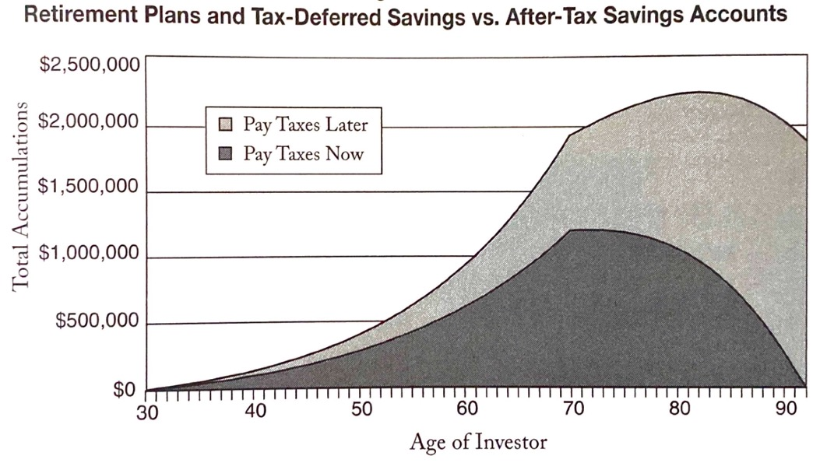
Tax-Deferred Retirement Accounts
Financial Basics for Attendings Your Greatest Tax Break
Lower taxes = Higher returns
Source: Retire Secure by James Lange

Slide 30
Tax-Deferred Retirement Accounts
Financial Basics for Attendings Your Greatest Tax Break
Why a 401(k) is awesome
  Upfront tax-break at 28%-37%
  Tax-protected growth
  Asset protection
  Easier estate planning
  401(k) withdrawals fill the tax brackets at withdrawal

Slide 31
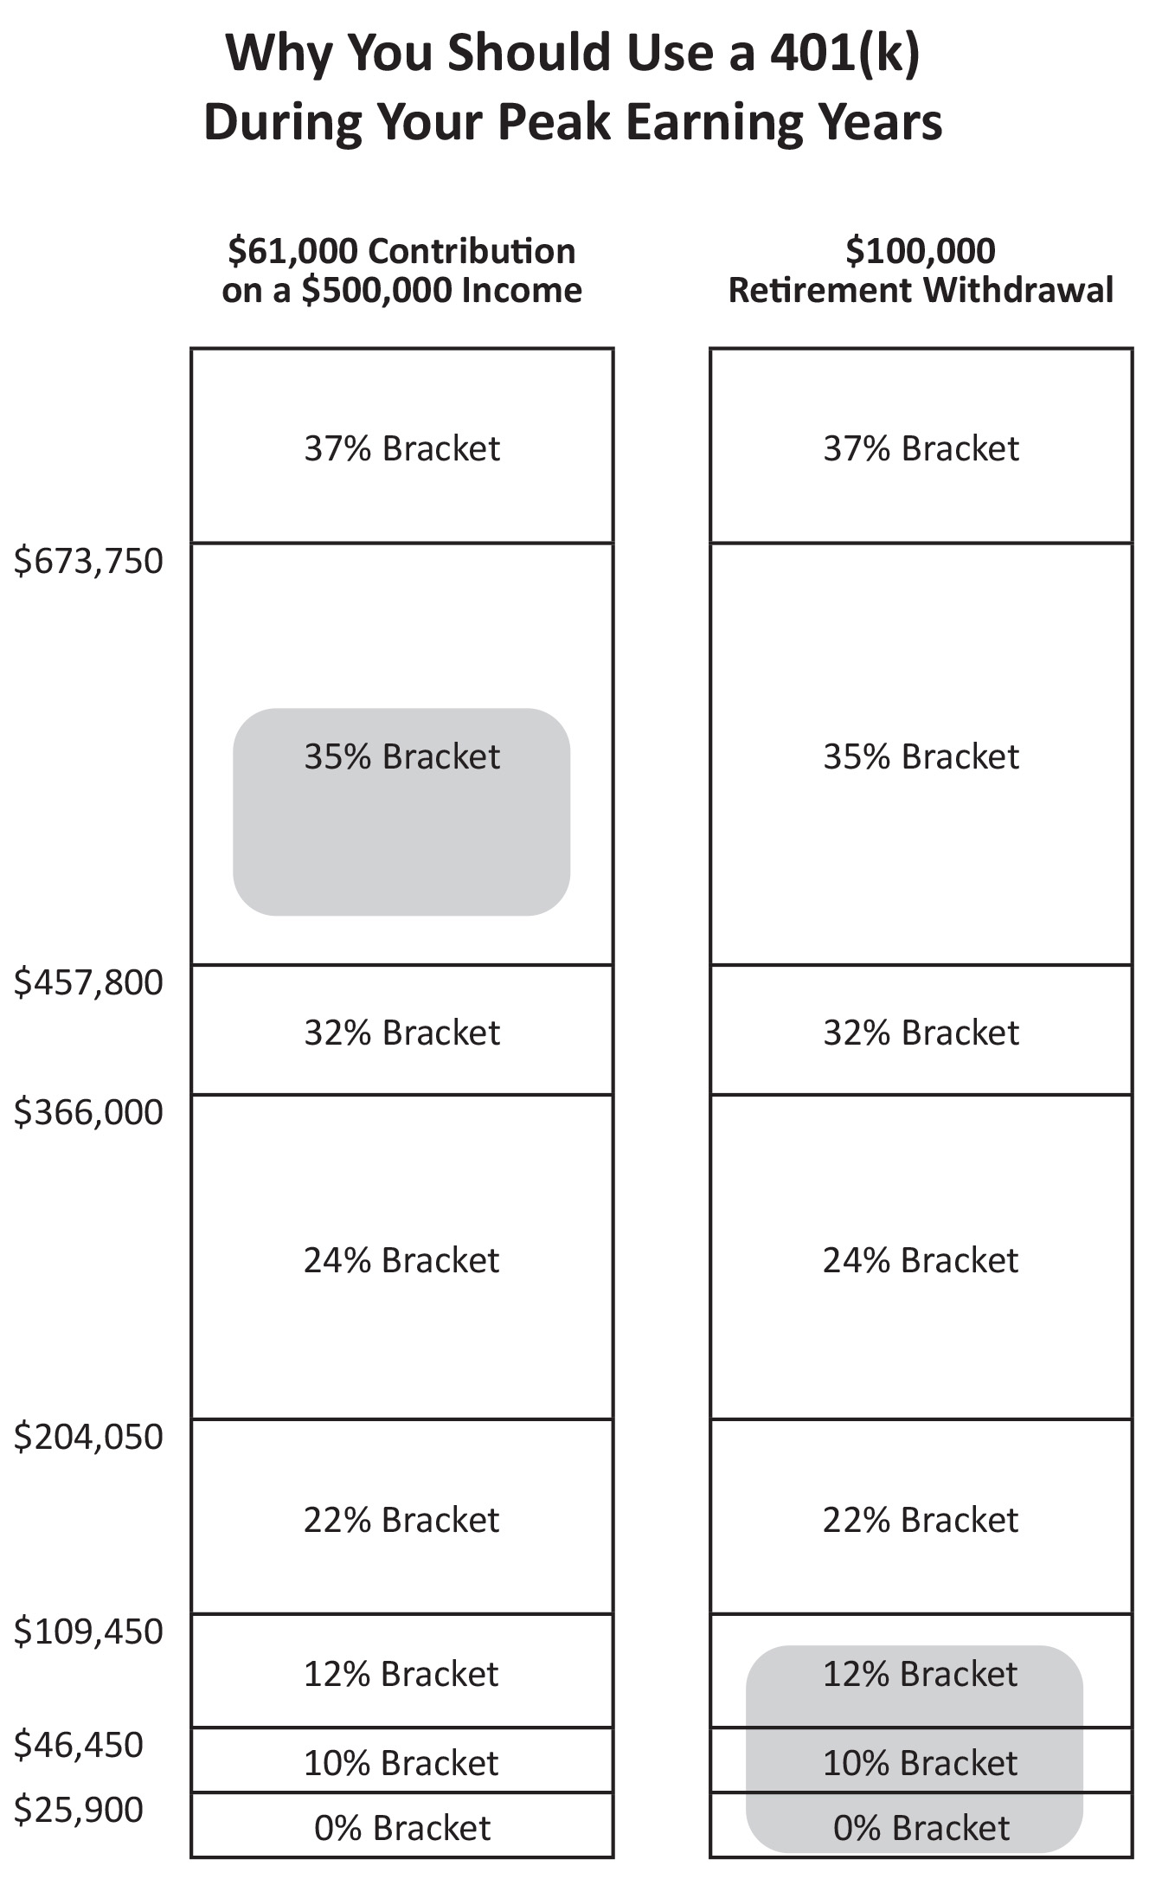
Retirement Accounts
Financial Basics for Attendings Your Greatest Tax Break
Assuming married couple, no other taxable income, and the standard deduction…
  First $25,900 per year comes out at 0%
  Next $20,550 per year comes out at 10%
  Next $63,000 per year comes out at 12%
  Next $94,600 per year comes out at 22%
  Next $161,950 per year comes out at 24%
Notes:
Note the text is updated for 2020 but the chart is not.

Slide 32
Retirement Accounts
Financial Basics for Attendings Your Greatest Tax Break
You can pull out >$360,000 per year at a marginal rate no higher than 24%
  Effective rate 19%
  On $100,000, effective rate is ~ 8%
For most doctors, even with Social Security, your effective tax rate is likely to be <20% in retirement
Saving at 37% and paying at 7% is a winning strategy
RMD on a $5 Million IRA at age 72? Only $180K

Slide 33
The Backdoor Roth IRA
Financial Basics for Attendings Your Greatest Tax Break
Until 2010, high earner could not
  Deduct a traditional IRA contribution
  Contribute directly to a Roth IRA
  Convert tax-deferred money to a Roth IRA
In 2010, Roth conversions were made legal

Slide 34
The Backdoor Roth IRA
Financial Basics for Attendings Your Greatest Tax Break
How It Works
Contribute to traditional IRA (no deduction available due to your income)
Convert traditional IRA to Roth IRA
Beware the pro-rata rule.
Fill out Form 8606 properly on your taxes
  Ensure no SEP-IRA, SIMPLE IRA, or traditional IRA money as of December 31
  Convert small IRAs to Roth IRA (paying taxes)
  Roll large IRAs into a 401(k)

Slide 35
The Backdoor Roth IRA
Financial Basics for Attendings Your Greatest Tax Break
You can also do it for a spouse
$6,000 for each of you each year
$7,000 if 50+
Taxable and not asset protected vs
Never taxed again and 100% asset protected
The choice is yours

Slide 36
Using Your HSA Wisely
Financial Basics for Attendings Your Greatest Tax Break
Must have a High Deductible Health Plan
HSA is the only triple tax-free account
  Tax-deduction for contribution
  Tax-protected growth
  Tax-free withdrawals if used for health care
  $3,600 ($7,200 married) for 2021 (plus $1,000 if 50+)
First account to contribute to each year
After 65, can be spent on anything penalty-free
Withdrawals need not be in same year as spending

Slide 37

The Case for Index
Funds

Slide 38
No One Has a Crystal Ball
Financial Basics for Attendings The Case for Index Funds
You need a plan likely to succeed no matter what happens in the future
Nobody knows nothing
CXO Advisory group evaluated stock market predictions
  6,582 stock market predictions
  1998 to 2012
  68 gurus
  47.4% accurate

Slide 39

Mutual Fund Managers Don’t
Have a Crystal Ball
“On Persistence in Mutual Fund Performance,” Carhart, 1997
  Analyzed 1892 funds from 61-93
  Average actively managed fund underperformed by 1.8%.

Slide 40


What Do the Experts Say?
"Of the 355 equity funds in 1970, fully 233 of those funds have gone out of business. Only 24 outpaced the market by more than 1% a year. These are terrible odds."
- Jack Bogle
"A low-cost index fund is the most sensible equity investment for the great majority of investors. My mentor, Ben Graham, took this position many years ago, and everything I have seen since convinces me of its truth."
- Warren Buffet

Slide 41
Pick a Reasonable Investing Plan
Financial Basics for Attendings The Case for Index Funds
Broadly diversified between asset classes
  Stocks, bonds, real estate, etc
Broadly diversified within asset classes
  Index funds hold thousands of securities
Low cost (2-20 basis points per year)
Appropriate amount of risk
Fixed asset allocation
Rebalance periodically
When you realize “nobody knows nothing” it frees you to quit wasting time on activities that don’t add value

Slide 42

The Basics of Estate
Planning

Slide 43
You Don’t Need the Same Estate Plan as Bill Gates and Warren Buffett
Financial Basics for Attendings The Basics of Estate Planning
Estate plans can be very simple
3 Purposes of estate planning
  Make sure what you want to happen with your children and your money
  actually happens
  Avoid probate
  Avoid estate taxes

Slide 44
Basics of Estate Planning
Financial Basics for Attendings The Basics of Estate Planning
A will dictates who will care for your kids if you die and who will manage
the assets you leave behind on their behalf

Slide 45
Estate Planning
Financial Basics for Attendings The Basics of Estate Planning
Avoid probate
  Can take a year and cost $20K or more
  Use beneficiary designations
    Bank accounts
    Brokerage accounts
    Retirement plans
    Insurance policies
  Pay on death accounts
  Revocable trusts

Slide 46
Estate Planning
Financial Basics for Attendings The Basics of Estate Planning
Federal Estate Taxes are not a big deal
  Don’t buy life insurance because the agent says you’ll need it for estate planning
  $12.92M can be passed on without paying ANY estate taxes ($25.84M married)
  Now permanent and indexed to inflation
  Most doctors won’t pay estate taxes
  States with estate/inheritance tax
    CT, DE, DC, HI, IA, IL, KY, MA, MD, MN, NE, NJ, NY, OR, PA, RI, VT, TN, WA

Slide 47
If You Have an Estate Tax Problem
Financial Basics for Attendings The Basics of Estate Planning
Give it away
  Gift Tax Exclusion $17K/year/recipient in 2023
  Spouse can also give $17K/year
Irrevocable trusts are for getting money out of your estate
  Highly taxed (highest bracket starts at $14,451 in 2023)
  Often used with permanent life insurance – put in $17K/year, then beneficiary gets hundreds of thousands estate and income tax free

Slide 48

The Basics of Asset
Protection

Slide 49
Malpractice Statistics
Financial Basics for Attendings The Basics of Asset Protection
8% of emergency docs are sued each year
93% of malpractice suits are dismissed or settled
Of those that go to court, the doc wins 79% of the time
That leaves 1.47% of suits that doctors lose in court
Most awards are less than policy limits
Of verdicts that award more than policy limits, many are reduced on appeal
Less than a 1/10,000 chance of being sued for more than your policy limits in any given year

Slide 50
Who Is Most Likely to Take Your Money?
Financial Basics for Attendings The Basics of Asset Protection
Doctors are rarely sued for more than their malpractice limits
Doctors lose much more wealth to divorce than to professional or personal lawsuits
Marriage generally increases net worth, but do it right the first time
Be careful “putting everything in my spouse’s name”

Slide 51
Asset Protection Laws Are State-Specific
Financial Basics for Attendings The Basics of Asset Protection
Know your state’s laws
What assets are protected from creditors in bankruptcy?
  Retirement accounts?
  Home equity?
  Cash value life insurance?
  Annuities?
Notes:
Note to presenter: Personalize this slide according to the state you are presenting in: https://assetprotectionsociety.org/state-asset-protection-laws/

Slide 52
Be Careful with Complex Asset Protection Plans
Financial Basics for Attendings The Basics of Asset Protection
Since risk of being sued above your limits is similar to winning (losing) a lottery, be careful how much money, time, and effort you spend “insuring” against the possibility
Buy malpractice and personal liability insurance
Max out your retirement accounts
Tenants by the entirety titling
  Your home
  Investing accounts in some states

Slide 53
Asset Protection Pearls
Financial Basics for Attendings The Basics of Asset Protection
Separate toxic assets from safe assets
  Rental properties in LLCs
  Incorporating doesn’t protect from malpractice, but it does from other business creditors/lawsuits
Asset protection plans don’t have to be expensive
  You don’t need one until you have assets that aren’t protected in other ways
Don’t tell people you’re a doctor

Slide 54
What We Learned
You have a second job
Get loans forgiven or refinance and pay them off
Get good advice at a fair price
Insure only against financial catastrophe
Know and use your retirement accounts
Index funds are your best default investment
Get a will and a trust – designate beneficiaries
Date night is your best asset protection technique

Slide 55



For free unbiased financial tools and resources, go to whitecoatinvestor.com
Listen to the
White Coat
Investor Podcast
Have Money Questions?
  reddit.com/r/whitecoatinvestor/
  facebook.com/groups/whitecoatinvestors

